Slide 1
Let’s Deploy ML Models

Slide 2
What’s planned for today?
Why Deployment?
Generalised Client-server architecture
Importance of cloud
Using Built-in ML models from GCP and AWS
Custom Server configuration

Slide 3
Google’s ML model vs Your ML model
Scalable
Continuous model evaluation and refinement
Trained using decoupled data ( PS: Google doesn’t collect your data -_- )

Slide 4
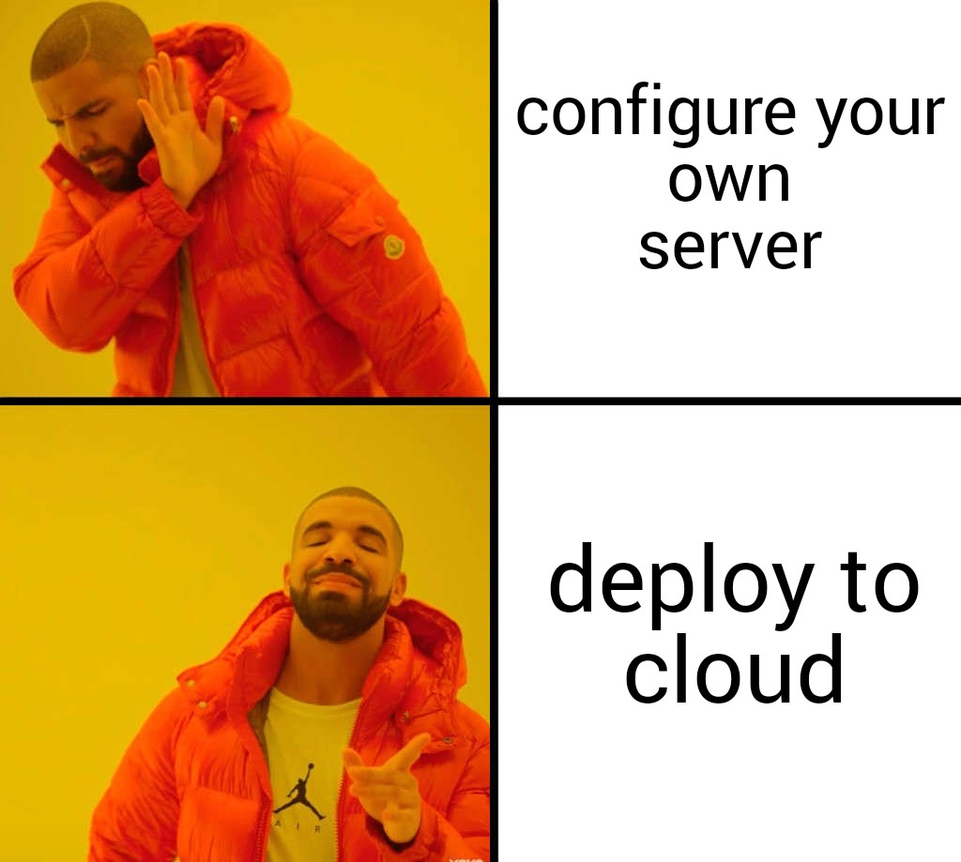

Why deployment? -The model has to be deployed to handle real-time data.
How?

Slide 5
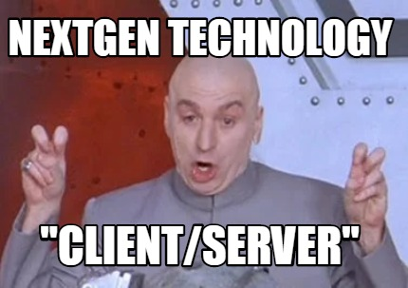
Client-Server Architecture
Distribute the workflow and seperate the workload
Implement request-reply protocol

Slide 6
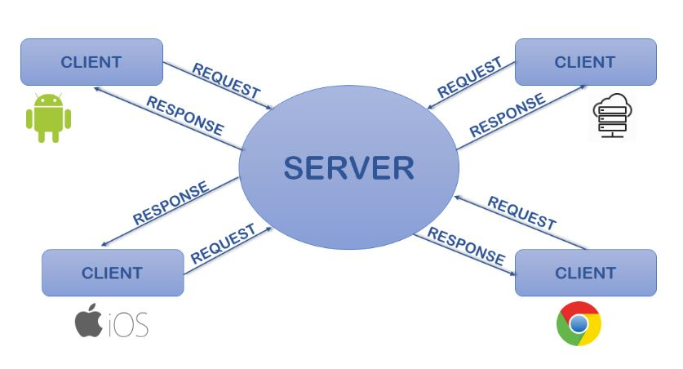
Handling various platforms!

